Slide 1
Video 0: Ana's Intro

Slide 2
Video 1: Intro & Recap

Slide 3
Let's go back to our previous task and dataset
Dataset:
Year
Customer_id - unique id
Phone_no
Gender
Age
No of days subscribed - the number of days since the subscription
Multi screen - does the customer have a single/ multiple screen subscription
Mail subscription - customer receive mails or not
Weekly mins watched - number of minutes watched weekly
Minimum daily mins - minimum minutes watched
Maximum daily mins - maximum minutes watched
Weekly nights max mins - number of minutes watched at night time
Videos watched - total number of videos watched
Maximum_days_inactive - days since inactive
Customer support calls - number of customer support calls
Churn -
1- Yes
0 - No
Task:
XYZ is a service providing company that provides customers with a one year subscription plan for their product.
The company wants to know if the customers will renew the subscription for the coming year or not.

Slide 4
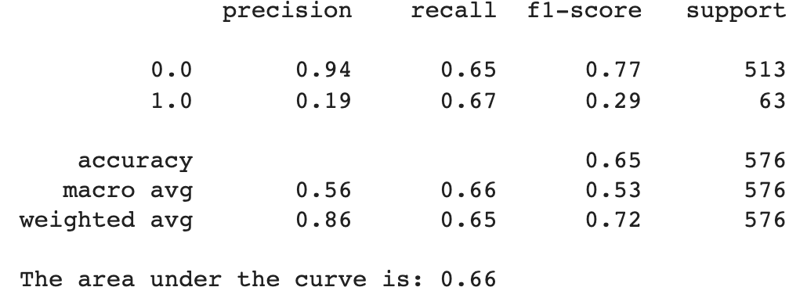
Logistic regression only took us thus far

Slide 5
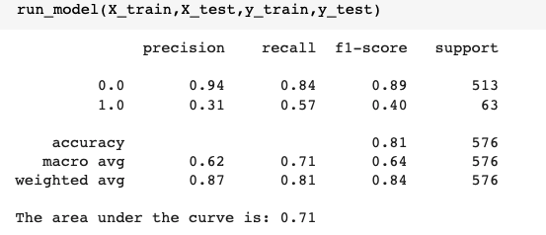
A Decision Tree improved our results

Slide 6
What are decision trees?
Root
Is multi-screen?
Leaf
Node
Yes
No
Not Churn
Minutes watched > 60?
Yes
No
Leaf
Leaf
Not Churn
Churn

Slide 7
Video 2:
Introduction to Ensemble Learning

Slide 8
Ensemble learning is combining several models in order to produce one optimal predictive model, more powerful than the original one
In the context of decision trees, there's a lot we can do there. In this course, we'll be talking about 2 ensemble learning techniques in the context of decision trees:
Bagging
Boosting
Notes:
One of the things we can do to improve our machine learning models is combining several of them. This is called ensembled learning

Slide 9
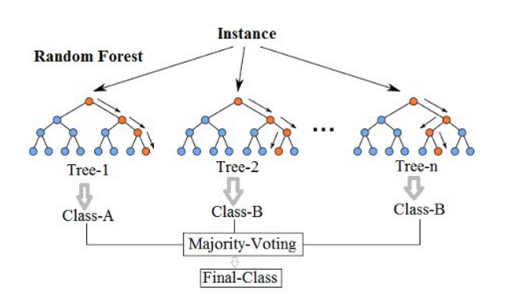
Bagging in decision trees
The idea is to sample across the original dataset
For each sample, we can build a decision tree
For each element, each decision tree will predict a class
The ensemble prediction is a 'vote' across all trees for the class of that element
Most common application: Random Forest
Notes:
One of the things we can do to improve our machine learning models is combining several of them. This is called ensembled learning

Slide 10
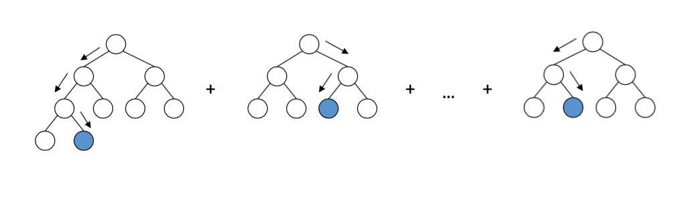
Boosting in Decision Trees
The idea is to build sequential models
Each model tries to solve for the errors of the previous one
The final model aims to be much better than the initial one
Most common application: ADABoost, XGBoost
Notes:
One of the things we can do to improve our machine learning models is combining several of them. This is called ensembled learning

Slide 11
Video 3:
Random Forests

Slide 12
Random Forest Step by Step:
Dataset with N observations and F features
1. Split dataset in training and test
2. For the first tree, sample with replacement from the N observations
3. Randomly select a subset of the F features
4. Fit a decision tree - without any restriction on depth
5. Repeat the steps to create n trees
6. Vote across all the n trees to decide on the class of a particular observation O
Notes:
One of the things we can do to improve our machine learning models is combining several of them. This is called ensembled learning

Slide 13
A note on probabilities
Decision Tree Probabilities
The number of observations of class A that are in that leaf over the entire number of observations in the leaf during training
Random Forest Probabilities
Proportion of decision trees that vote for a particular class

Slide 14
Video 4:
Random Forests in Python

Slide 15
Video 5:
Adaptive Boosting
(ADA Boost)

Slide 16
Recap - How decision trees make the split

Slide 17
For each feature:
Calculate the Gini Index of the Node and each leaf
Calculate the Gini of the split (weighted average of Gini of each leaf)
GiniNode = 1 - (⅜ )^2 - (⅝ )^2 = 0.87
GiniSplit = (4*0.5 + 4*0.35)/8 = 0.42
If Gini of split < Gini of Node, then split - Else don’t split
GiniChild = 1 - (½ )^2 - (½ )^2 = 0.5
Chose to split on the feature that does the 'best possible split'
Max Gini Gain = Gini Node - Gini of the Split
GiniChild = 1 - (¼ )^2 - (¾ )^2 = 0.35

Slide 18
Adaptive Boosting
Dataset with N observations and F features
Similar to a random forest, we'll also build several trees
However, this trees will be simpler, using only one feature to make the split. Those trees will be a decision stump
The building of the trees will be sequential, with each new tree learning from the previous trees mistake
Instead of having trees voting with equal weight, the sequential process will attribute new weights to new trees
Notes:
One of the things we can do to improve our machine learning models is combining several of them. This is called ensembled learning

Slide 19


Adaptive Boosting
Dataset with N observations and F features
For each observation in your dataset, you are going to give it a weight. At first, all observations have the same weight = 1/N
Build your first decision tree. This stump is split only on one one the variables. To find the variable to use, you will use the same technique to find the first split of a decision tree.
Calculate the weight of this stump. This measures how well the decision tree classified the samples
The more errors > The lower the weight
Notes:
One of the things we can do to improve our machine learning models is combining several of them. This is called ensembled learning

Slide 20

Adaptive Boosting
Dataset with N observations and F features
Recalculate the weight of each sample. For that, you will use the Weight of the Stump:
The more errors > The higher the weight
Recreate a new dataset, using the weights to duplicate the observations that have more weight
Notes:
One of the things we can do to improve our machine learning models is combining several of them. This is called ensembled learning

Slide 21
Adaptive Boosting
Dataset with N observations and F features
Recreate a new dataset, using the weights to duplicate the observations that have more weight
So if I only had 3 samples
Sample 1- weight 0.25
Sample 2- weight 0.25
Sample 3 - weight 0.5
I would create a dataset where I would have something like:
Sample 1
Sample 2
Sample 3
Sample 3
Proportion of sample 1 = 0.25
Proportion of sample 2 = 0.25
Proportion of sample 3 = 0.5
Reset the weights of the observations, and re-do the creation of the stump. Repeat until the desired # of iterations
Notes:
One of the things we can do to improve our machine learning modelsReset the weights of the observations, and re-do the creation of the stump. Repeat until the desired # of iterations
is combining several of them. This is called ensembled learning

Slide 22
Adaptive Boosting
Dataset with N observations and F features
After all the models are built, decide in which class observation N will fit. To do that, sum the model weights of all models that predicted a + class, and compare the model weights of the models that predicted a - class. If the model weights of a + class are higher than -, predict positive - otherwise predict -.
Notes:
One of the things we can do to improve our machine learning modelsReset the weights of the observations, and re-do the creation of the stump. Repeat until the desired # of iterations
is combining several of them. This is called ensembled learning

Slide 23
Video 6:
Adaptive Boosting
(ADA Boost) in Python

Slide 24
Video 7:
Gradient Boosting

Slide 25
Key Concepts to understand
gradient boosting
Weak learner (-Decision Stump): Each individually ‘bad’ model (decision trees)
Additive Model: An iterative process to add one model to the previous one, improving the loss function
Loss Function: How good is the model in making predictions
Notes:
One of the things we can do to improve our machine learning models is combining several of them. This is called ensembled learning

Slide 26

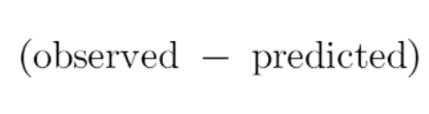
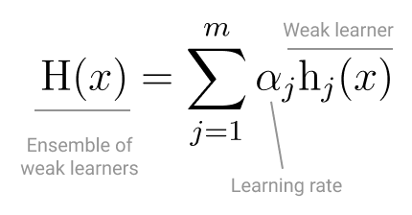
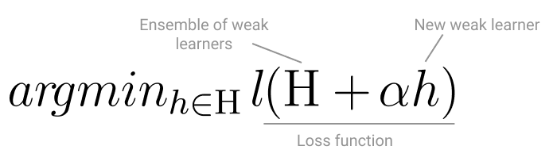
Gradient Boosting Application for
Classification
Loss Function:
Math transformations
Weak learner: Decision Trees
Additive Model:
Finding the next week learner: Gradient descent
Notes:
One of the things we can do to improve our machine learning models is combining several of them. This is called ensembled learning

Slide 27
Gradient Boosting:
Dataset with N observations and F features
1. Fit your first week learner - a decision tree
2. Using all the observations you got wrong, fit another decision tree.
3. Add this decision tree to your previous one, considering the learning rate. The Loss Function should have decreased in this process
4. Calculate the residuals of this model, and repeat the fitting of another decision tree
5. Proceed until you do all the steps you parameterized to do
Notes:
One of the things we can do to improve our machine learning models is combining several of them. This is called ensembled learning

Slide 28
Gradient Boosting:
Dataset with N observations and F features
1. Number of trees: usually set between 100-200
2. Learning rate - tends to be small:
Let’s say you need 5.24 models
If your learning rate is 1, you will land in 5 or 6
But if your learning rate is 0.1, you will land in 5.2 or 5.3 - which is closer to the optimal
Notes:
One of the things we can do to improve our machine learning models is combining several of them. This is called ensembled learning

Slide 29
XGBoost (Extreme gradient boosting)
1. Solves for slow computation problems of Gradient Boosting -> Allows for parallelization
2. Uses distributed computing, cache optimization and out-of-core computing
Notes:
One of the things we can do to improve our machine learning models is combining several of them. This is called ensembled learning

Slide 30
Video 9:
Evaluating the algorithm in Python

Slide 31
Video 10:
Explaining the Algorithm with LIME

Slide 32
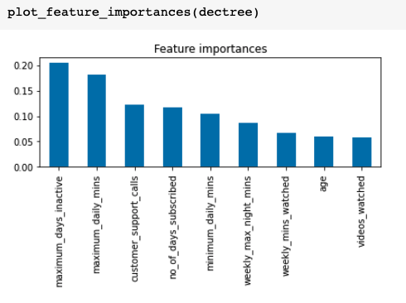

Feature Importance
Decrease in node impurity weighted by the proportion of samples on a given node
Proportion of samples on each node
Importance of feature f
Gini gain on the node
Sum across all nodes that split on f

Slide 33
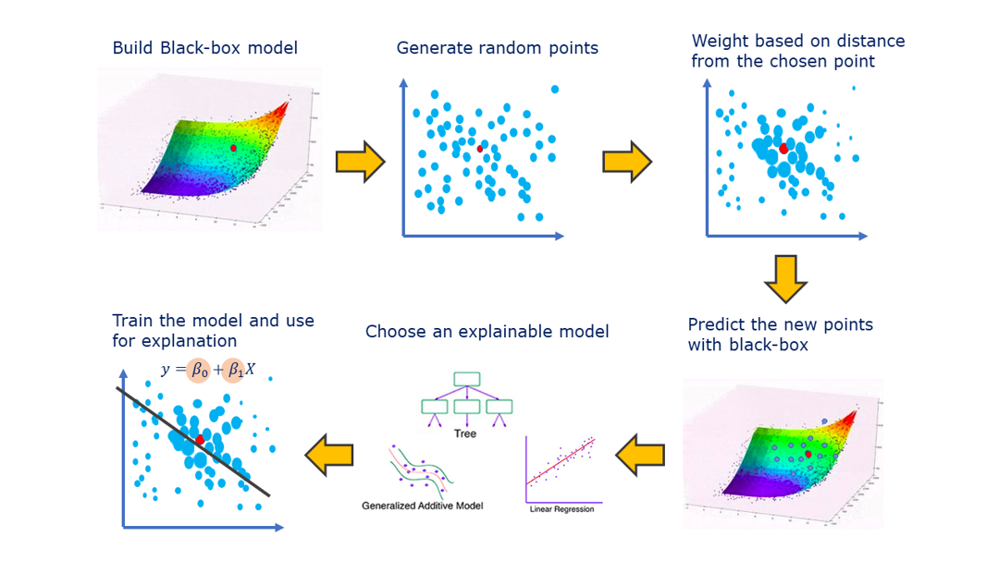
Check this great article here >> LIME by Giorgio Visani
Notes:
One of the things we can do to improve our machine learning models is combining several of them. This is called ensembled learning

Slide 34
Video 11:
Implementing LIME with Python

Slide 35
Link to the google sheets
Link to Ensemble techniques google sheet

